Slide 1
Decision Trees
Sunil Kumar
Business Analyst

Slide 2
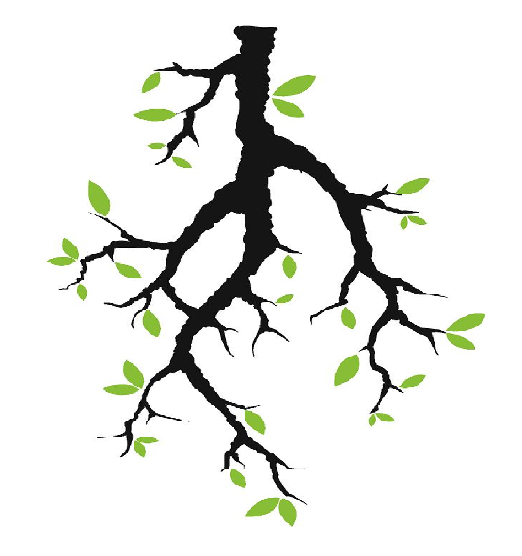
Decision Tree
A decision tree a tree in which each branch node represent a choice between number of alternatives.
A decision tree is a supervised learning algorithm, which is utilized for both classification and regression tasks.
A decision tree follows a set of if-else conditions to visualize the data and classify it.
It is one for the advantages of Decision Trees compared to other classification models such as Logistic Regression or SVM, that we do not need to carry out one hot encoding to make these into dummy variables.

Slide 3
Type of Decision Tree
Decision Tree Regression
Decision Tree Classifier

Slide 4
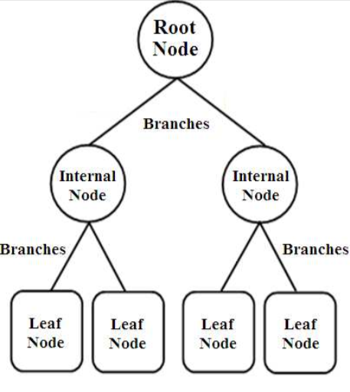
Decision Tree Overview

Slide 5
Important Terminology
Root Node: This is the node that begins the splitting process by finding the variable that best splits the target variable
Branch or Sub-Tree: A part of the entire decision tree is called a branch or sub-tree.
Splitting: Dividing a node into two or more sub-nodes based on if-else conditions.
Decision Node: After splitting the sub-nodes into further sub-nodes, then it is called the decision node.
Leaf or Terminal Node: This is the end of the decision tree where it cannot be split into further sub-nodes.
Pruning: Removing a sub-node from the tree is called pruning.
Entropy: Entropy is a measure of disorder or impurity in a node.
Information Gain: Information gain is the basic criterion to decide whether a feature should be used to split a node or not.
Gini Index: The Gini Index works on categorical variables and gives the results in terms of “success” or “failure” and hence performs only binary split.
Gini Impurity: Gini Impurity is a measurement used to build Decision Trees to determine how the features of a dataset should split nodes to form the tree.

Slide 6
Advantages
Disadvantages
Intuitive and easy to understand
Minimal data preparation is required (handling missing values etc.)
The cost of using the tree for inference is logarithmic in the number of data points used to train the tree (slightly fast in speed , as it works on one column one time).
It is great chance to have overfitting in your decision tree models.
Prone to errors for imbalanced datasets.

Slide 7
Basics Steps of Decision Trees
1.Identify the root node: To identify the root node we would evaluate the impact of all the variables that we have currently on the target variable (identify the variable that splits the target variable into the most homogenous groups).

Slide 8
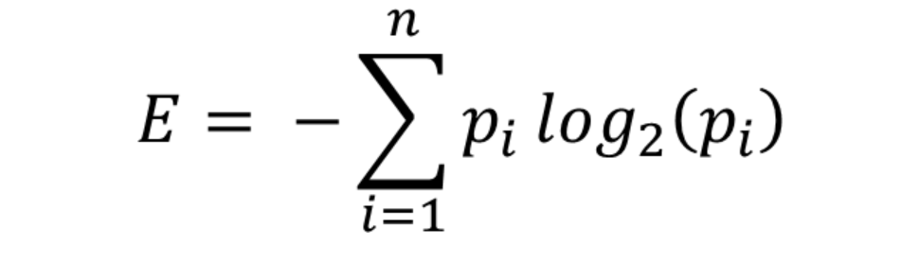
Entropy
Entropy is nothing but the measure of disorder. Or you can also call it the measure of purity/impurity.
To select the best node/feature of decision tree model, we need entropy.
More Knowledge less entropy.
Decision Trees Explained — Entropy, Information Gain, Gini Index, CCP Pruning | by Shailey Dash | Towards Data Science
Entropy is measured by the formula:

Slide 9
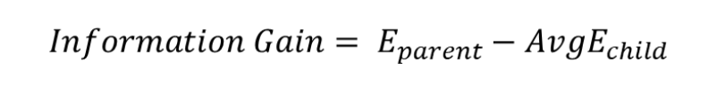
Information Gain
For this we have to calculate a potential split from each variable, calculate the average entropy across both or all the nodes and then the change in entropy vis a vis the parent node. This change in entropy is termed Information Gain and represents how much information a feature provides for the target variable.

Slide 10

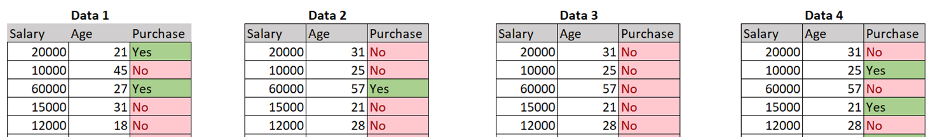
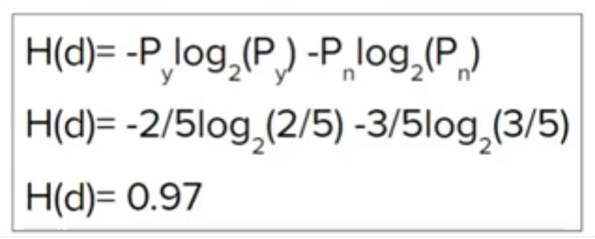
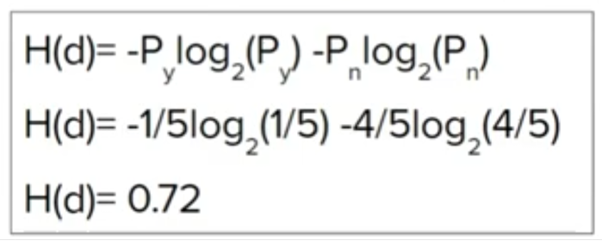
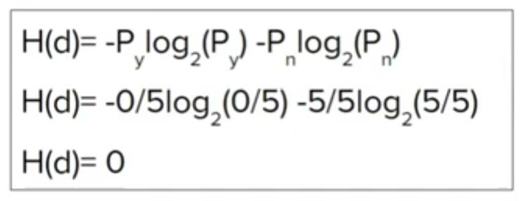
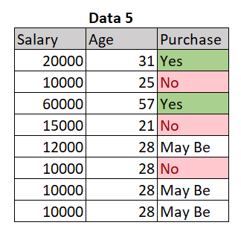
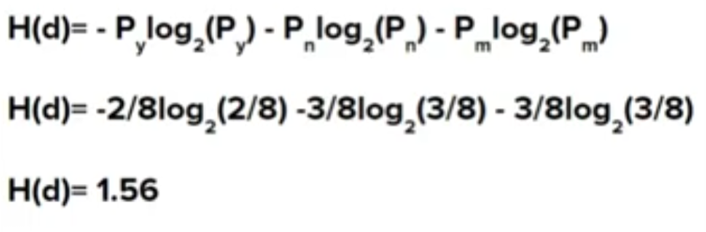
Entropy
Conclusion
The lesser entropy 0 – is the pure node.
When we have binomial data we get entropy between 0 to 1 (0 is better)
When we have more than 2 data entropy may greater than 1

Slide 11
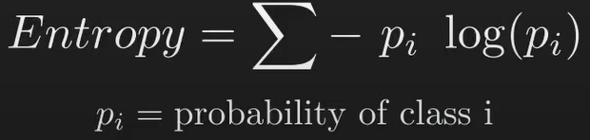
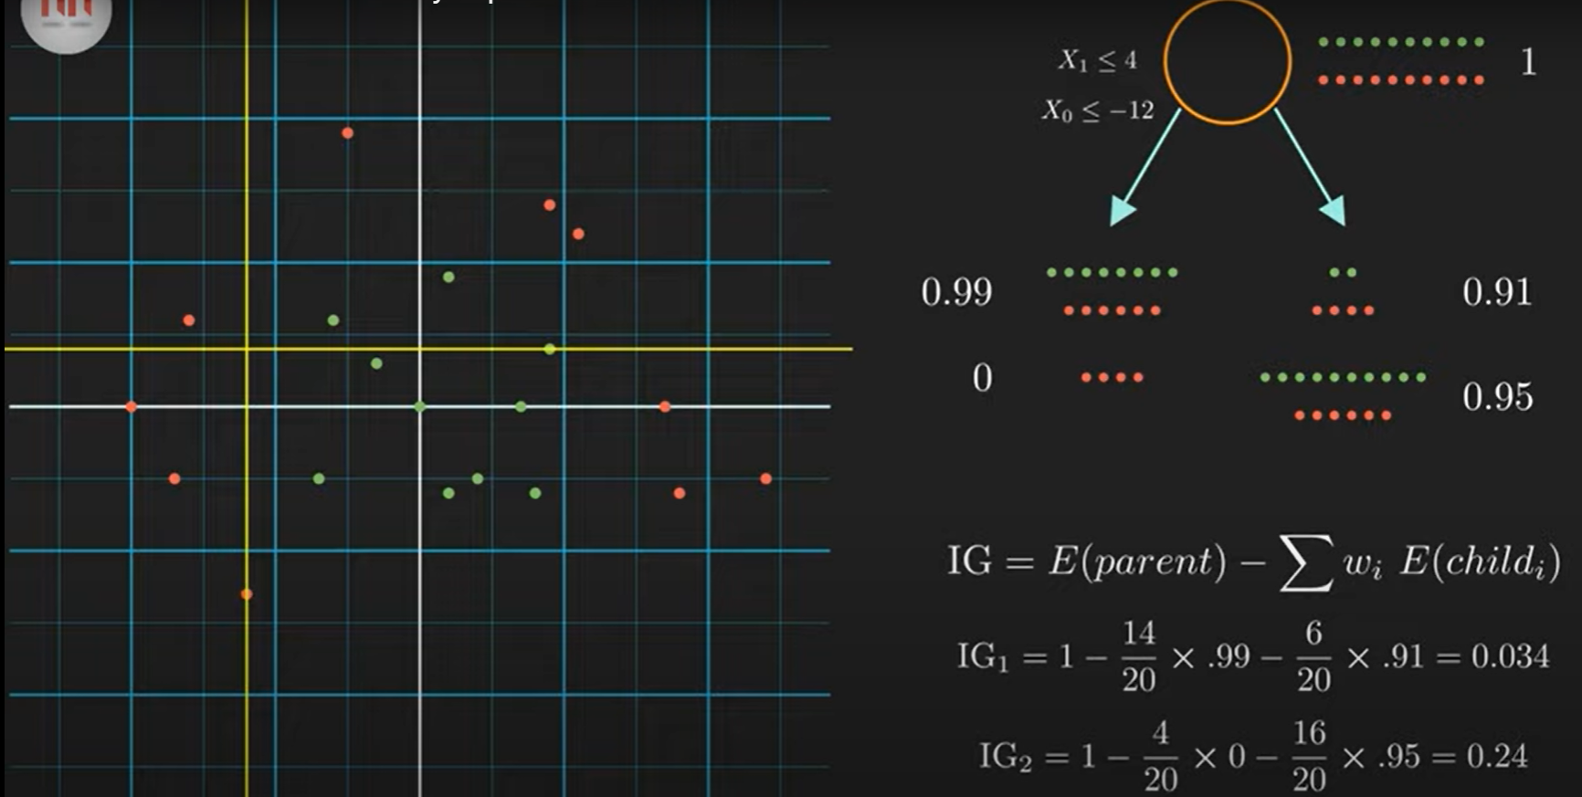
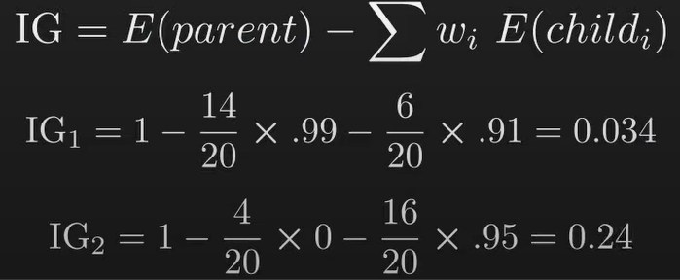
Entropy and Information Gain
Calculation of Entropy:
Calculate the entropy of parent and all child nodes
Entropy of parent node is 1 = -0.5log(0.5)- 0.5log(0.5)
Entropy of 4 items is 0. That is why we call is a pure node.
Calculation of Information Gain:
For IG we will subtract the E of parent node from E of child node.
We can see the Information Gain of IG2 is greater , it means we will choose this node as root node or for further split.
The same way system will calculate the information gain for all feature and pick the greater one.

Slide 12
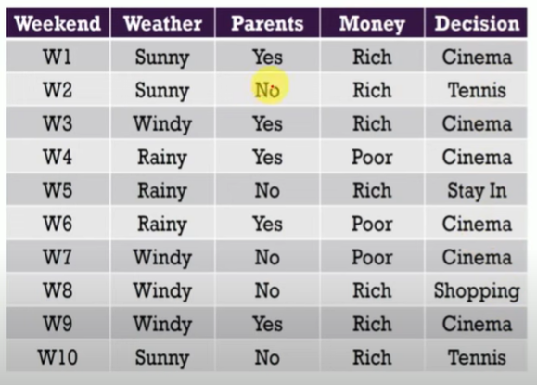
Dataset
We must calculate proportionate of output column. Here we have 6 output, e.g. Cinema - 6 times, Tennis - 2 times, Stay = 1 instances , Shopping - 1 instance

Slide 13
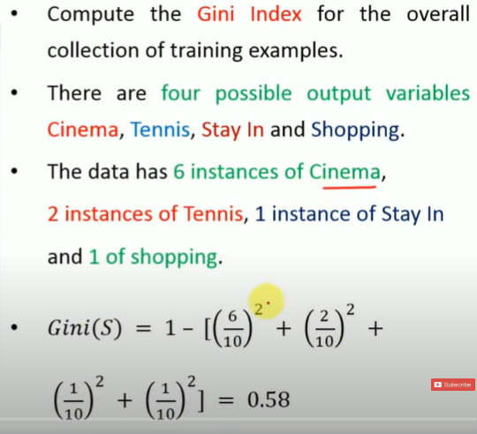
Dataset
Gini of output columns is .58
Now, we will try to calculate the Gini of each Independent Variable and based on their Gini value we will pick one of the I.V as root nod.

Slide 14
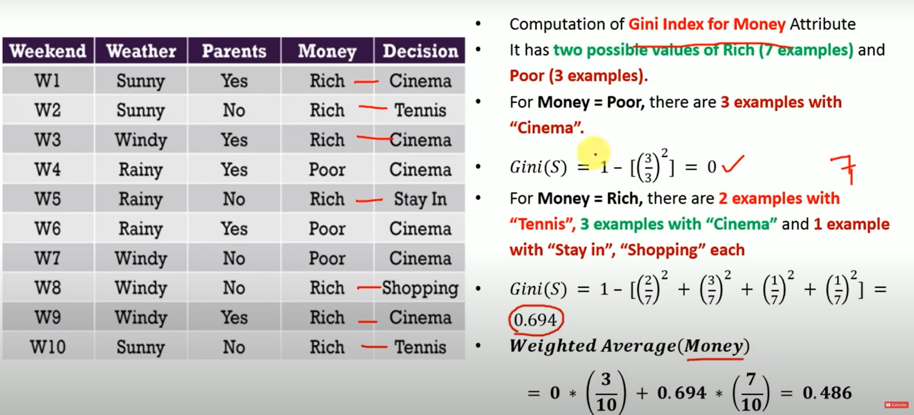
Gini Index for Money

Slide 15
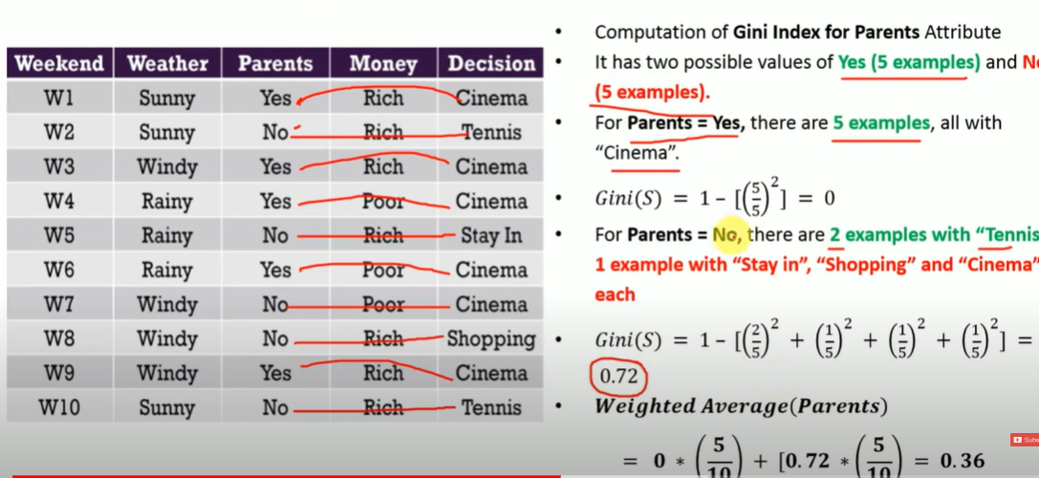
Gini Index for Parents

Slide 16
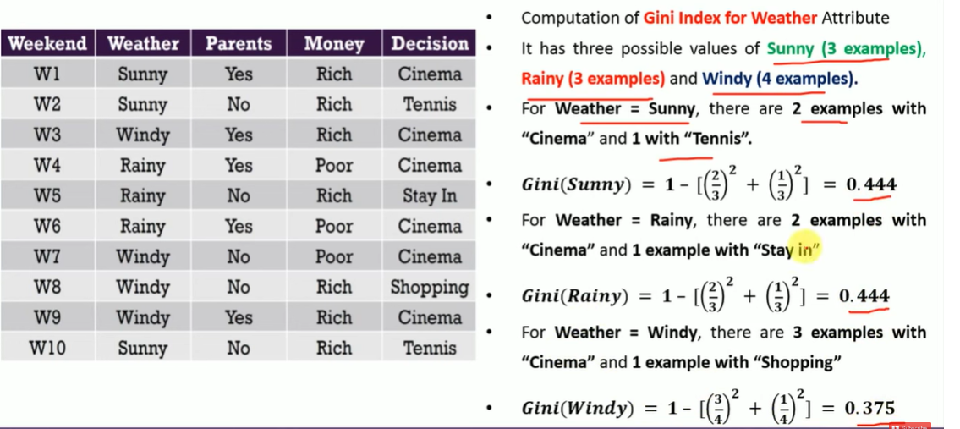
Gini Index for Weather

Slide 17
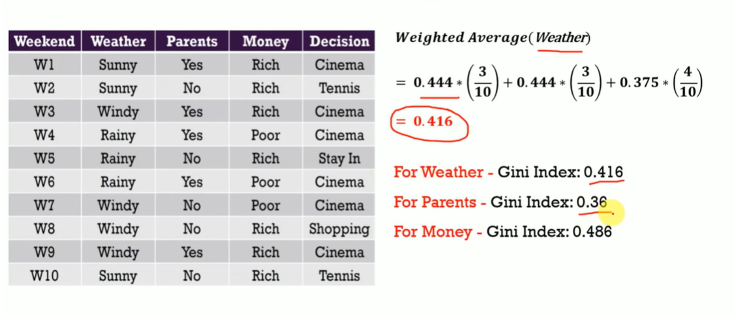
Now, we have calculated the Gini for all Independent Variable below
We can see the minimum gini index value for - Parents , means this I.V. has the maximum information. Hence, we will take Parents column as our Root Node.

Slide 18
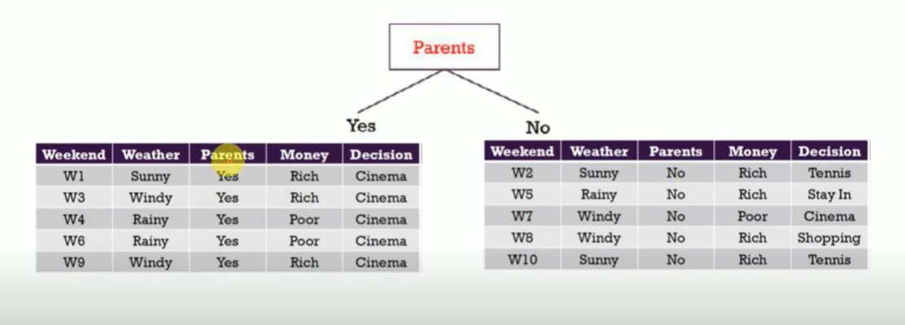
Since we have taken the root node as Parent column - we will divide data into two parts:
If Parents Yes - then no need for further investigation .... However, in case NO - we have to perform further steps:
Now, we have to calclate when parents is NO - and Weather Attribute

Slide 19
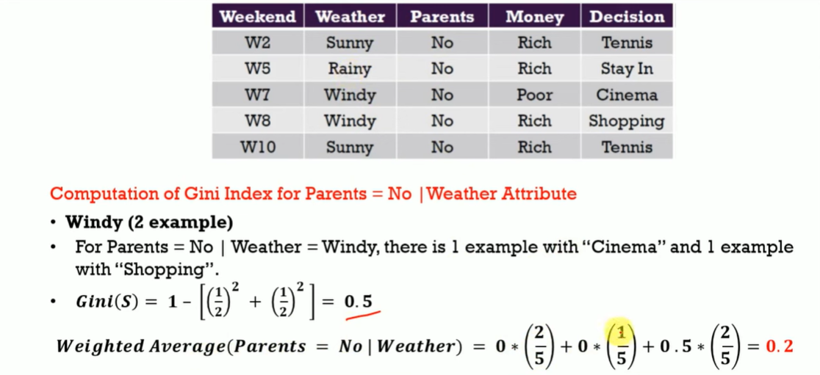

Slide 20
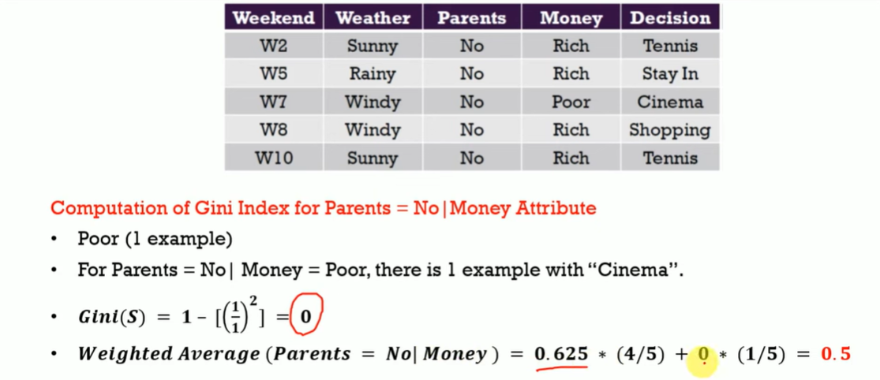
Now, we have to calculate when Parent is NO and Money Attribute

Slide 21
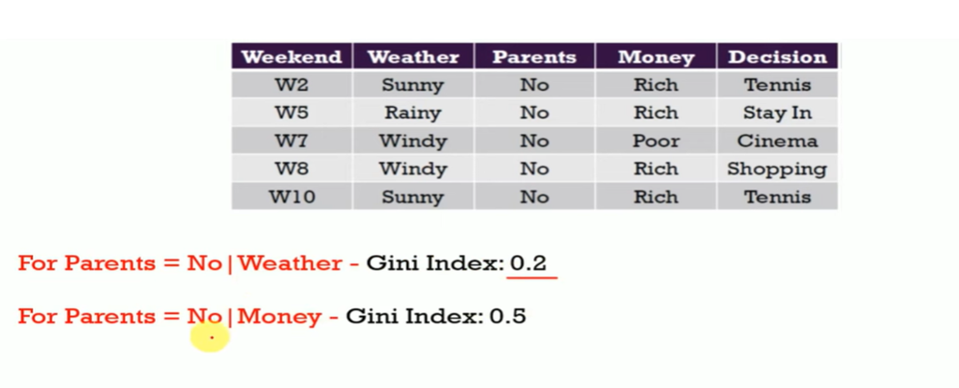
Gini Index of second node

Slide 22
Important Fact
If we use Information Gain as a criterion, we assume that our attributes are categorical, and as per Gini index, we assume that our attributes are continuous.

Slide 23
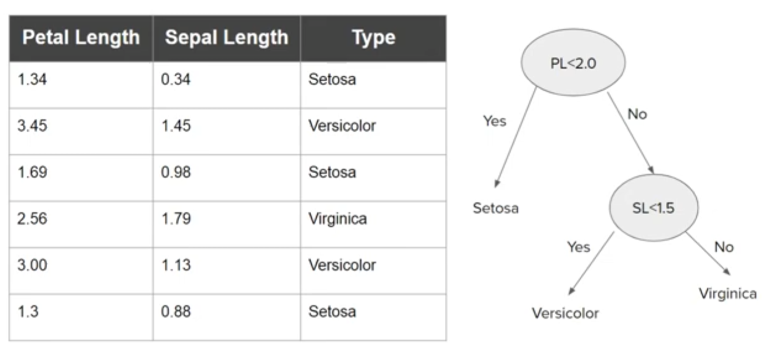
Decision Trees for Numeric Data

Slide 24
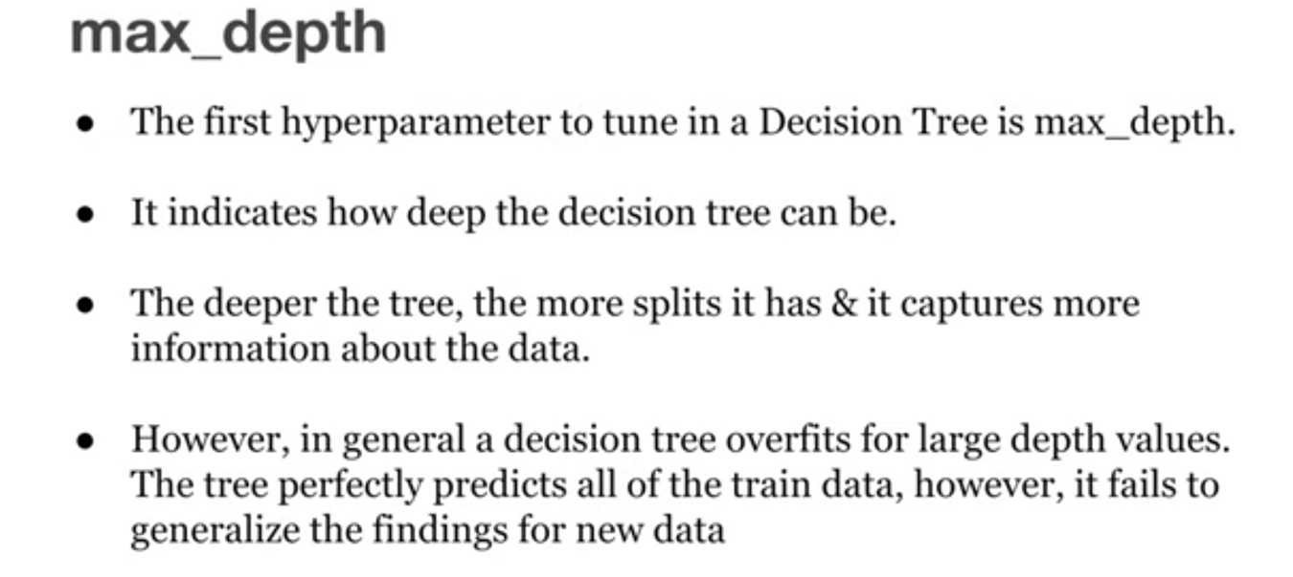
Hyperparameters of Decision Trees

Slide 25
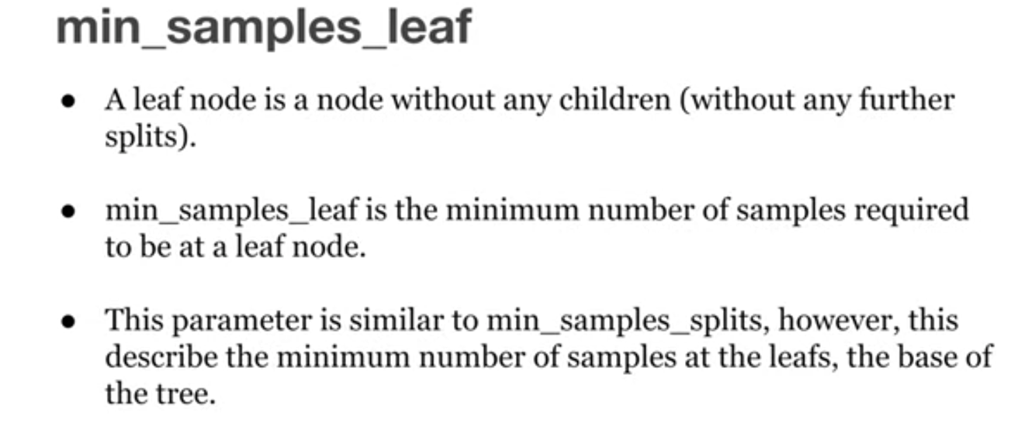
Hyperparameters of Decision Trees

Slide 26
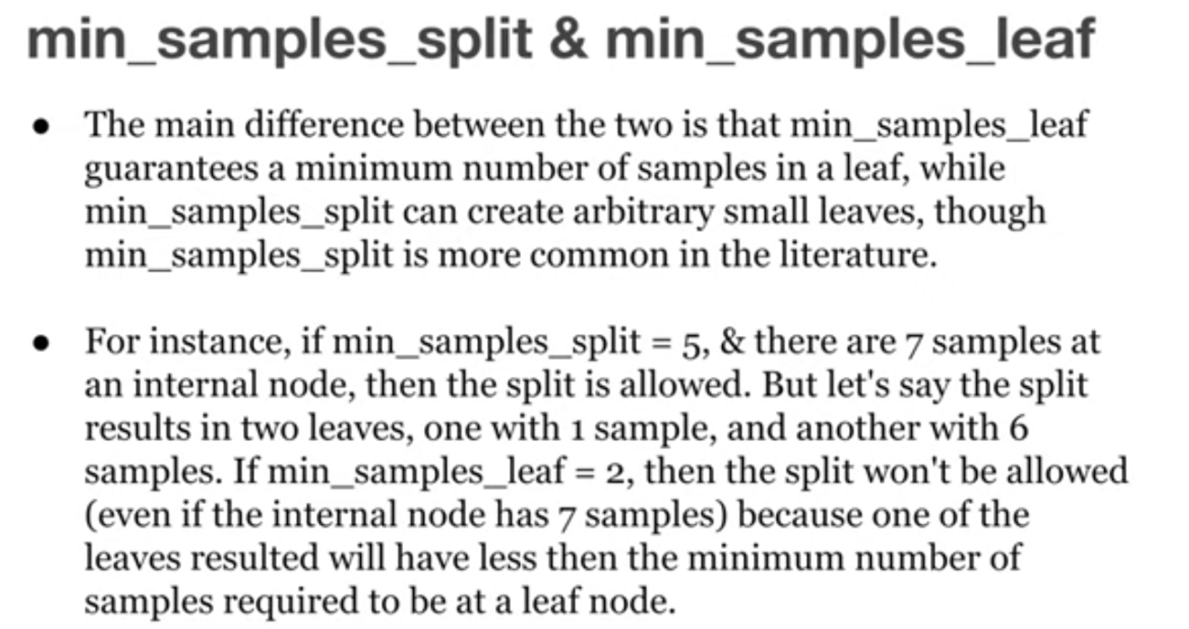
Hyperparameters of Decision Trees

Slide 27
Hyperparameters of Decision Trees

Slide 28
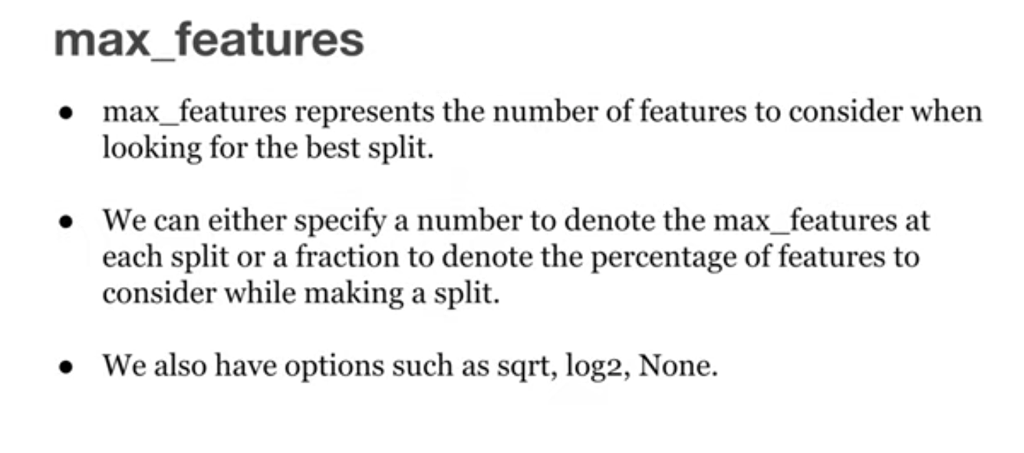
Hyperparameters of Decision Trees

Slide 29
Important Questions
How to decide which column should be considered as root node?
How to select subsequent decision nodes?
Based on numeric features how the decision tree has been constructed.
Based on numeric features how the decision tree has been constructed.
Impact of outliers in decision tree? And how you handle outliers in decision trees.
How to decide splitting criteria in case of numerical columns.
Decision tree are normally low bias and high variance. So, in decision tree how you will make high variance to low variance?
What you understand by Decision Tree Pruning? Hyper parameter tuning

Slide 30
Conclusion
Decision trees are nothing but a giant structure of nested if-else condition.

Slide 31
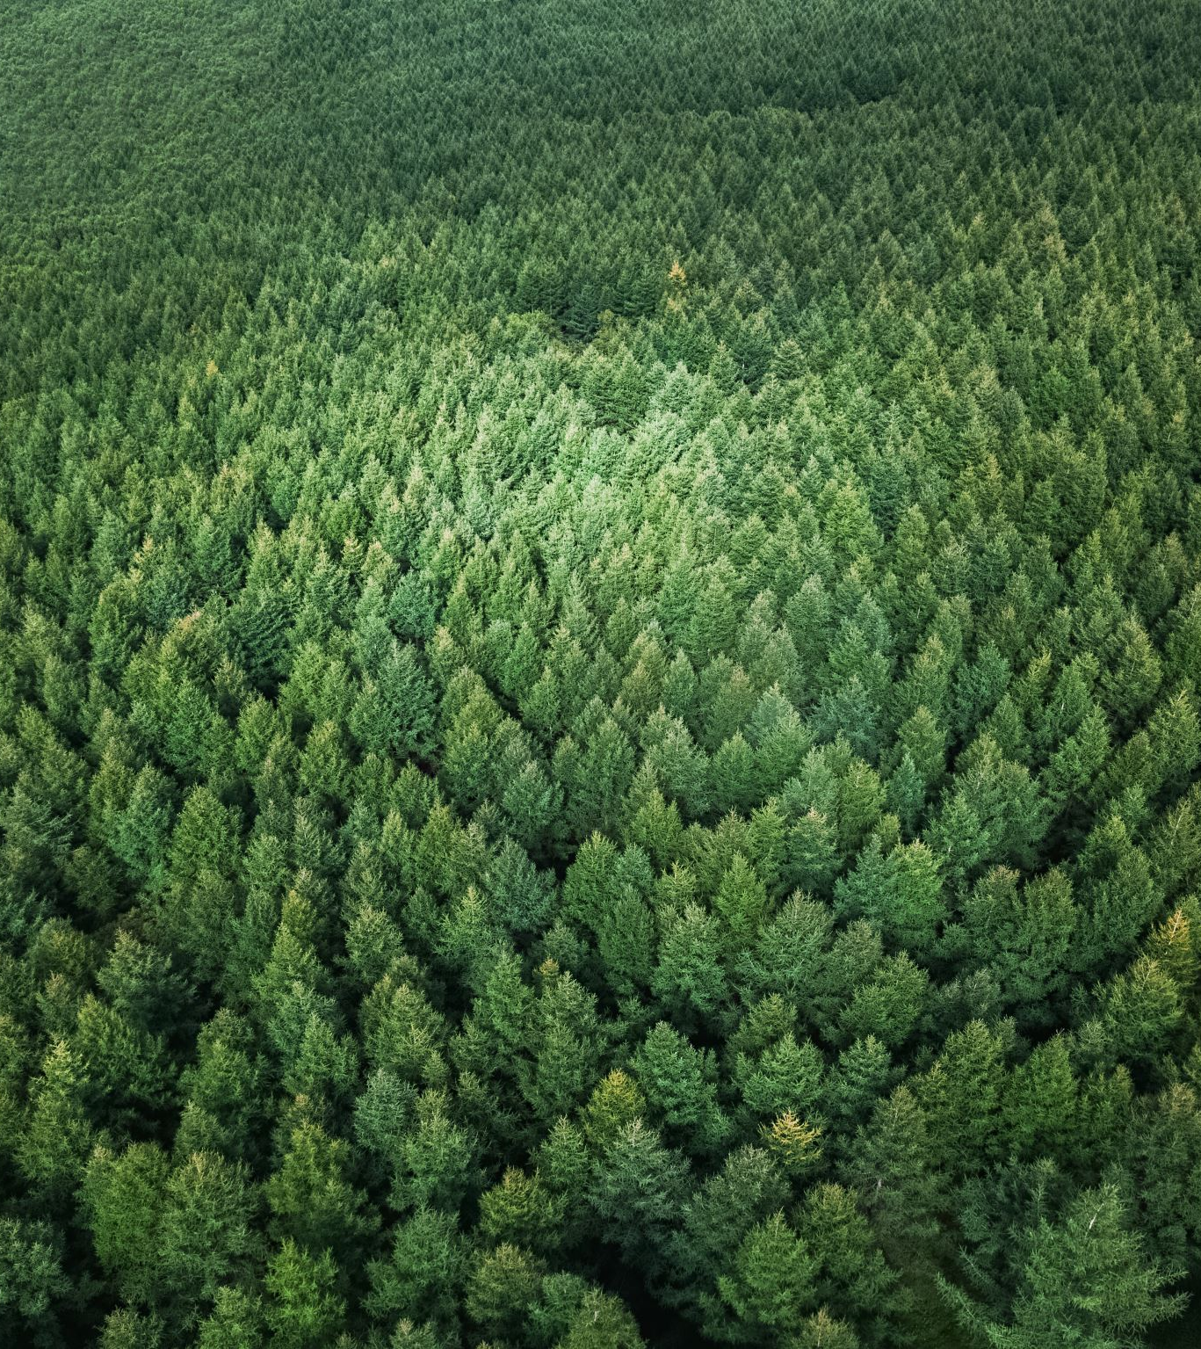
Random Forest Classifier

Slide 32
Random Forest Classifier
Random Forest is one of the most popular and commonly used algorithms by Data Scientists. Random forest is a Supervised Machine Learning Algorithm that is used widely in Classification and Regression problems.
It builds decision trees on different samples and takes their majority vote for classification and average in case of regression.

Slide 33
How does the Random Forest algorithm work?
Step 1: The algorithm select random samples from the dataset provided.
Step 2: The algorithm will create a decision tree for each sample selected. Then it will get a prediction result from each decision tree created.
Step 3: Voting will then be performed for every predicted result. For a classification problem, it will use mode, and for a regression problem, it will use mean.
Step 4: And finally, the algorithm will select the most voted prediction result as the final prediction.

Slide 34
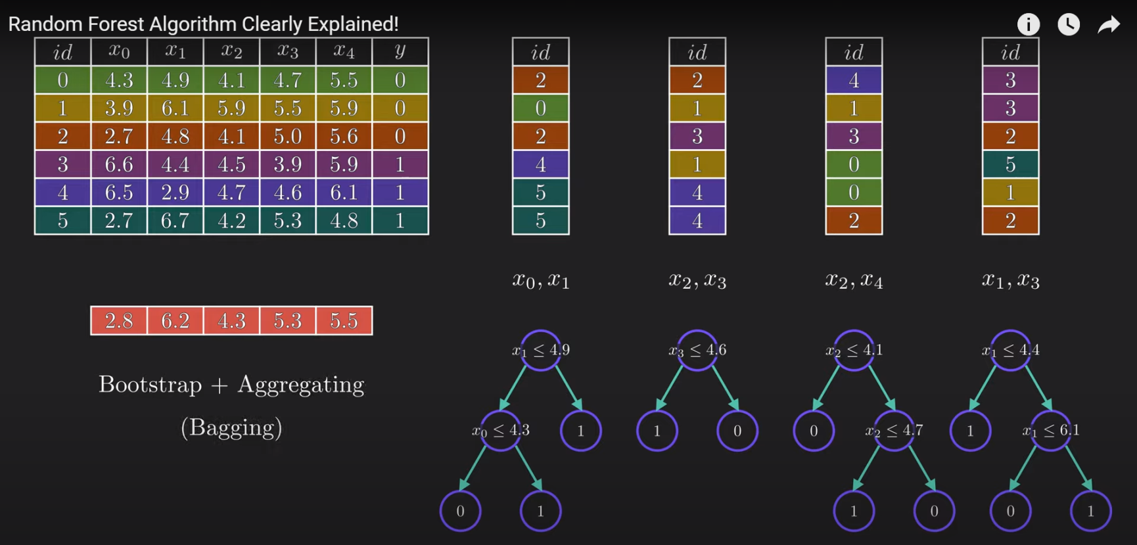
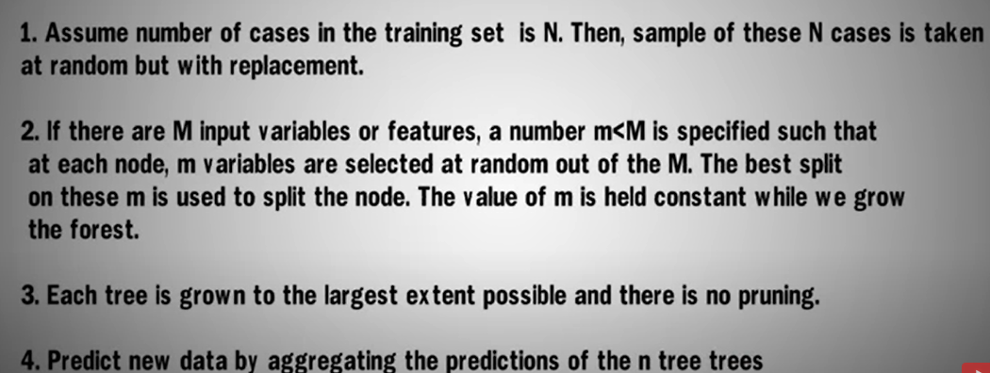
Random Forest PseudoCode
By sampling with replacement, means some of the data points may be repeated in each new training data set.

Slide 35
How does the Random Forest algorithm work?
It uses bagging and feature randomness when building each individual tree to try to create an uncorrelated forest of trees whose prediction by committee is more accurate than that of any individual tree.
Random forest tends to combine hundreds of decision trees and then trains each decision tree on a different sample of the observations. The final predictions of the random forest are made by averaging the predictions of each individual tree.

Slide 36
Bagging
Bagging (Bootstrap Aggregation) — Decisions trees are very sensitive to the data they are trained on — small changes to the training set can result in significantly different tree structures.
Random forest takes advantage of this by allowing each individual tree to randomly sample from the dataset with replacement, resulting in different trees. This process is known as bagging.

Slide 37
Advantages
Handle the missing values and maintains accuracy for missing data. Missing values are substituted by the variable appearing the most in a particular node.
The decision trees tend to overfit to the training data, but random forest can mitigate that issue by averaging the prediction results from different trees.
Handle large dataset with high dimensionality.
Among all the available classification methods, random forests provide the highest accuracy.
Random Forest is very versatile and can be used in both regression and classification tasks. It can also handle all binary, categorical, and numerical features.

Slide 38
Disadvantages
Black Box Approach: You have very little control on what the model does.
No understanding of model calculations, everything calculated behind the screen and have no manual intervention.
It consumes more time compared to a decision tree algorithm.
The decision tree in a forest cannot be pruned for sampling (no control on model).
Good job at classification but not good as for Regression.

Slide 39
Important Facts
How many features to be considered in Random Forest?
Researchers says that the value close to the sqrt of the total number of features is the best number of features to be use in Random Forest.
Does it work differently for Classification and Regression?
For classification, the measure of impurity is either the Gini impurity or the information gain/entropy.
For regression the measure of impurity is variance.
Does it work differently for Classification and Regression?
For classification, the measure of impurity is either the Gini impurity or the information gain/entropy.
For regression the measure of impurity is variance.
Is Feature Selection possible with Random Forest Classifier?
The random forest algorithm can also help you to find features that are important in your dataset. It lies at the base of the Boruta algorithm, which selects important features in a dataset

Slide 40
Questions
What are Ensemble Methods?
Ensemble methods is a machine learning technique that combines several base models in order to produce one optimal predictive model.
Random Forest is a type of ensemble method.
How does Random Forest handle missing values?
Fill in the missing values with the median (for numerical values) or mode (for categorical values). This method will brush too broad a stroke for datasets with many gaps and significant structure.
How would you improve the performance of Random Forest?
Using a higher quality dataset and feature engineering. Using too many features and data are not good for the model so sometimes it is important to perform some feature reduction too.
Tuning the hyperparameters of the algorithm.
Is Feature Selection possible with Random Forest Classifier?
The random forest algorithm can also help you to find features that are important in your dataset. It lies at the base of the Boruta algorithm, which selects important features in a dataset

Slide 41
Feature Selection from Random Forest
First
import pandas as pd from sklearn.ensemble import RandomForestClassfier from sklearn.feature_selection import SelectFromModel
sel = SelectFromModel(RandomForestClassifier(n_estimators = 100)) sel.fit(X_train, y_train)
Second
# check Important features
feature_importances_df = pd.DataFrame(
{"feature": list(X.columns), "importance": classifier.feature_importances_}
).sort_values("importance", ascending=False)
# Display
feature_importances_df

